Slide 2
Welcome to the
Smooth Rock Falls
Hospital FOUNDATION

Slide 3
History
With a view to answer the capital needs of the Smooth Rock Falls Hospital, in 2013-2014, a group of people decided to do fundraising activities. They quickly realized that in order to obtain various funds, it was preferable to become an incorporated entity.
A rather lengthy process to become a charitable organization was started and in 2016 we were incorporated.
Founding Members : Marielle Cousineau, Chantal Tessier,
Melonie Loubert, Wayne McGee, Fabien Hébert

Slide 4
Goals and mandate
Sustain the capital needs of the Smooth Rock Falls Hospital

Slide 5
Board of Directors members
2019-2020
Marielle Cousineau, chairperson Melonie Loubert, vice-chairperson Mérianne Latour, secretary / treasurer Monique Pinard, member Carole Cloutier, member *Chantal Tessier
* resigned

Slide 6
Board of Directors members
2020-2021
Marielle Cousineau, chairperson Melonie Loubert, vice-chairperson Mérianne Latour, treasurer Monique Pinard, member Carole Cloutier, secretary
Lina Arseneault, member
Hélène (Gervais) Gillissie, member

Slide 7
Board of Directors members
2021-2022
Marielle Cousineau, chairperson Melonie Loubert, vice-chairperson Mérianne Latour, treasurer Monique Pinard, member Carole Cloutier, secretary
Lina Arseneault, member
Hélène (Gervais) Gillissie, member

Slide 8
Recognition policy
Policy
The Smooth Rock Falls Hospital and its Foundation, the Fondation HSRFH Foundation recognizes donors for their gifts through formal and informal, personal and public expressions of appreciation. The Hospital and the Foundation recognizes the importance of the contributions to the Foundation and reiterates the right of donors to receive proper recognition and appreciation for their donations.

Slide 9
Procedure
1. The foundation will acknowledge receipt of all gifts and or donations received in an effort to express gratitude and support for its foundation.
2. A wall size plaque is erected in a designated area of the hospital as a wall of recognition.
3. Donor Recognition Guidelines will be as follows:

Slide 10
Legend
Under $100.00 Receipt only
Over $100.00 /under $1,000 - A thank you card from the Foundation will be sent to the donor
Over $1,001 / under $4,999 - A thank you card from the Foundation President and Hospital CEO will be sent to the donor
Over $5,000 / under $9,999 Bronze plaque under the title of Collaborateur / Partner
Over $10,000 /under $24,999 Silver plaque under the title of Bienfaiteur / Benefactor
Over $25,000 / under $49,999 Gold plaque under the title of Bâtisseur / Builder
Over $50,000 / under $99,999 Platinum plaque under the title Fondateur / Founder
Over 100,000 + Dedication of a space in the Hospital i.e., room with a negotiated timeframe under title of Visionnaire / Visionary

Slide 11
4. Donors who should be recognized is defined as all individuals, corporations, service clubs, community organizations, and philanthropic foundations who make monetary gifts or gifts-in-kind donations to the Fondation HSRFH Foundation. These gifts may include donations to capital campaigns, direct mail, email or facebook requests, memorials, tributes, endowments, special events, etc.
5. A donation or gift may be in different forms
Gifts of cash
Gifts-in-kind
Life insurance
Non-revocable gifts (i.e. planned gifts)
Bequests
Pledges
Sponsorships or third party events resulting in revenue for the Foundation

Slide 12
6. The HSRFH Foundation may amend its recognition policy from time to time in order to enhance and maintain the purpose of its policy in terms of equitable recognition and/or qualitative recognition.
7. The names of persons, companies, organizations or agencies donating to the Foundation will remain confidential until such time as they are published according to the Recognition guidelines (article 3).
8. The donor may request anonymity from public display.
9. Specific amount of a donation and terms of payment will be considered confidential at all times unless donor indicates otherwise in writing. i.e., donation amount

Slide 13
10. Access to information will be limited to Foundation staff and board.
11. Gifts will be acknowledged promptly and donors advised of the recognition policy.
12. Donor Wall will be up kept as deemed necessary.

Slide 14
Visionary ($100,000 +)
Mrs. Jeanne Renaud – 2014
The living room in the acute care unit is named in memory of Mrs Jeanne Renaud
The Marcel and Frances Labelle Foundation – 2017
The x-ray department is dedicated to the Marcel and Frances Labelle Foundation
The Marcel and Frances Labelle Foundation – 2020

Slide 15
Founder ($50,000 - $99,999)
Monkman Family Foundation – 2020
A plaque is placed in the flower garden by the gazebo, in memory of Raymonde and Rhéal Arseneault

Slide 16
Builder ($25,000 - $49,999)
La Caisse Populaire de Kapuskasing et région – 2017
La Caisse Populaire paid for the purchase of a defibrilator
La Caisse Alliance de Kapuskasing et région – 2020
La Caisse Alliance made a donation towards the Aging at Home accessible van

Slide 17
Benefactor ($10 000 $ - $ 24,999)
Estate of Mrs Pearl Marlow- 2020
Angèle Bizier in memory of Roger Bizier
Angèle made a donation towards the purchase of the accessible
van for the Aging at Home Program.
Monkman Family Foundation – 2023
Richard and Mona made a donation to help us enhance and maintain
the LTC backyard

Slide 18
Partner ($5,000 - $9,999)
TransCanada Pipelines Limited

Slide 19
Donations of $1,000 $ or less than $4,999
2017
Thérèse Blouin
Ontario Power Generation
2018
Lina Philippon
Yvette Boudreau
Edmonde Guindon
Yvon Ward
Lucienne Roman
Robert Ward
Le Club d'âge d’or Rayons de lune de Moonbeam
Ontario Power Generation

Slide 20
Donations of $1,000 or less than $4,999
2019
Carolyn Biglow
Knights of Columbus

Slide 21
Donations of $1,000 or less than $4,999
2020
Royal Canadian Legion – Br 305
André Bernier
Claudette Rousseau
Denis Lasalle

Slide 22
Donations of $1,000 or less than $4,999
2021
Jean-Yves Marquis
Donation in memory of Jean-Louis Dubord

Slide 23
Donations of $1,000 or less than $4,999
2022
Nicole Wittke Thomas Boyd
Chevaliers de Colomb

Slide 24
Donations of $1,000 or less than $4,999
2023
Lina Arseneault

Slide 25
Donations of $100 and less than $1,000
2017
Jean-Marc Bérubé Jeannine et John West
Edouard Gravel Gérald Bisier
Waleston Labonté Carole Thériault
Yolande Fortier Ann Coutu
Doris Dubé Suzanne Gravel
Lise Grenier Eliane Labonté-Bernier
Mérianne Latour Monique Pinard
Becky Plant Suzanne Wright
Mona Hazel Doris Petit

Slide 26
Donations of $100 and less than $1 000
2018
Gérald Bisier Cécile Michaud
Smooth Rock Falls Girl’s Hockey Gérald Bisier
Kevin Lebarron Claude Goulet
Town of Smooth Rock Falls Ken Vane
Céline Côté-McCuaig Ken Sword
Angèle Cousineau Town of Smooth Rock Falls
In Memory of Norma Hemingway Waleston Labonté
Louisa Brazzoni Kathy Taylor
Joanne Loubert Eleanor Cousineau
Suzanne Brunet Carole Cloutier
Ann Coutu Doris Dubé
Suzanne Gravel Lise Grenier
Eliane Labonté-Bernier Mérianne Latour
Brenda Lebarron Monique Pinard
Suzanne Wright Lina Arseneault
Ken Sword

Slide 27
Donations of $100 and less than $1,000
2019
Gérald Bisier Greg & Jean Kirkbride Robert Périgny
Ghislaine Clarke Thomas Vane Chantal Wilson
Tony Mungham Mona Monkman
Thomas and Karen Waleston Labonté
Gérald Bisier Lina Arseneault
Linda Biglow Normand Arseneault
Gérald Bisier Eleanor Cousineau
S R Falls Lions Club Suzanne Brunet
Anonymous Carole Cloutier
Yollande Fortier Ann Coutu
Karen Colaiezzi Suzanne Gravel
Randall & Cheryl Browne Eliane Labonté Bernier
Elly & Joe Colaiezzi Mérianne Latour
Irene Crozelle Brenda Lebarron
Ian & Lucie Colaiezzi Suzanne Wright

Slide 28
Donations of $100 and less than $1,000
2020
Kelly Gillis Gérald Bisier
Anonymous Chevalier de Colomb
Francine Boucher Lina Arseneault
Francine Boucher Joe and Alayne Couture
André Desbiens Carol Lavoie
Le Conseil des Arts de Hearst Cochrane Temiskaming Children’s Centre
Diane and Normand Labonté Lucette Lamothe
Bruno Goyette Waleston Labonté
Suzanne and Gilles Brunet Guy Rochon et Rachel Béchard-Rochon
Vincent Gravel Eliane Labonté-Bernier
Michael Huddart Waleston Labonté
Mérianne Latour Suzanne Wright
Claude and Shirley Grenier Tracie Faubert
Patrick Phelan Chris & Céline McCuaig
Patrick Phelan Cécile Michaud

Slide 29
Donations of $100 $ or less than $1 000
2021
Suzanne Brunet Tyler & Louise Thomson Guy & Suzanne Boivin
Jean-Yves & Nicole Leblanc John & Dianne Wood Yvette Keat
Hélène (Gervais) Gillissie Community Club Canteen OPG-Abitibi Canyon
Elise & Alain Corbin Tina & Patrick Rainville Luc Filion
Ghislaine Clarke Suzanne & Guy Boivin Claude Goulet
Suzanne Wiggins Nicole Gagné Marc St-Jean
Renald Cousineau Lina Arseneault Bernard Boulanger
Anonymous Anonymous Denis Brûlé
Marg Bizier France Bidal Jean Filion
Micheline Harrison Marielle Cousineau Hélène (Gervais) Gillissie
Family of Gérard et Roselyne Filion Gaetan Mercier
Pierre Brûlé Family of Gérard et Roselyne Filion
Family of Gérard et Roselyne Filion Eleanor Cousineau
Lina Arseneault David & Margaret Pachota Denis Lasalle
Thomas Vane Colette Bédard Marc Ward
Anonymous Pauline & Claire Sauvé

Slide 30
Dons de 100$ et moins que 1 000$
2022
Anita & Ronald Rochon Patricia & Michel Dubord Lina Arseneault
Patrick Phelan David & Margaret Pachota Lucienne Bernier
Patricia & Michel Dubord Guy Rochon Diane Papineau
Alayne & Jean-Marie Couture Mariette & Léonce Fortin Hélène Ménard
Chantal Marchand Deborah Foster Claude Goulet
Yvon Bernard Stella Drolet Madeleine Gravel
Town of Smooth Rock Falls Mérianne Latour Yvon St-Pierre
Terry & Mavis Pinkney Université de Hearst /Innovanor
Laurie & Lorraine Breault Alexis Klimack Anonymous
Dan & Marg Therrien Anonymous Claude Goulet
Theresa Roberts Anonymous Suzanne Martin
Irène Gravel Edmonde Guindon Solange McNeely
Cercle Ste Thérèse de l’enfant Jésus Claude Goulet
Clara & Emile Jacques George Long Diane Richard
Suzanne & Guy Boivin Hélène Gillissie Hélène Gillissie
Aline Ménard Yvon Bernard

Slide 31
Donations of $100 $ or less than $1 000
2023
Eliane Labonté Bernier Rose Marie Smith Stephanie Townsend-McKinnon
Michel Brideau Claude Goulet Anonymous
Gaetan Mercier Anonymous Noel Mercier
Ruth Ann Leroux Claude Goulet Margaret& David Pachota
Claude Goulet La famille Ubald Mercier Sue & Guy Boivin

Slide 32
Donations up to $100
2017
Marc Couture Lucie Larche
Léopold Carrier Doris Dubé
Paul et Roberte Hébert Sacha-Lee Hébert Cadieux
Chantal Tessier Suzanne Gravel
Clara Jacques Leslie et Denis Gagnon
Ken Vane Léopold Carrier
Héléne et Jean-Guy Poirier Sheila and Raymond Jacques
Mavis and Terry Pinkney Paul Hébert
Eliane et André Bernier Suzanne Brunet
Richard et Lyne Mercier Carole Cloutier
Suzanne Fraser Brenda Lebarron
Ian Colaiezzi Marilaine Tremblay
Sam Colaiezzi Clara et Emile Jacques
Maurice Demeules Hélène Poirier
Chantal Tessier

Slide 33
Donations up to $100
2018
Kathy Taylor Jean-Guy Poirier Sue Perras
Kathy Taylor Denise Labonté Pelletier Denis et Ethel Léonard
Paul Hébert Audrey et Gilles Loiselle Jeannette Cloutier
William Price Paul Hébert Marcelle Cadieux
Kathy Taylor Paul Hébert Jacqueline Sawyer
Thérèse Blouin Dianne et Ron Brown Denise Breton Parisé
Thérèse Blouin Elisabeth Mertens Marcel Parisé
Clara et Emile Jacques Angèle Cousineau Lise Simpson
Sheila Jacques Raymond et Colette Giroux Kathy Taylor
Angèle Sauvé Simone Pomerleau Kathy Taylor
Maurice Petit Ernest et Marie Demers France Chevalier
Rollande Dubé Jean-Yves Marquis Vincent Gravel
Albert Clément Alain et Joanne Filion Chantal Tessier
Laurent Leford Vincent Gravel Paul Hébert
Julie Bernier Hermann and Georgina Ens Lise Simpson
Viviane Gravel Maurice Demeules Lise Simpson
Hélène et Jean-Guy Poirier Roland et Jocelyne Grenier
Équipe Collège Boréal/Option emploi

Slide 34
Donations up to $100
2018…cont.
Judith Lévis Don et Mona MacKinnon Paul Hébert
Judith Lévis Jean-Guy Poirier Kathy Taylor
Réjeanne et Claude Demeules Kathy Taylor Judith Lévis
Norman et Annette Audet Kathy Taylor Leona Noel
Marilaine Tremblay Maurice Demeules Chantal Tessier
Roland et Jocelyne Grenier Gilbert et Lynne Pelletier Larry Simpson
Rémi Gravel et Monique Boucher René et Lorraine Cloutier
Judith Lévis Léo et Cécile Tessier
Judith Lévis Robert et Marge Bizier
Vincent Gravel Clara et Emile Jacques
Leslie Gagnon Jacquie Hamilton
Real Mainville Jacquie Hamilton
France Chevallier Claudette Rousseau
Léo et Yvonne Pelchat Thérèse Blouin
René et Louisette Sicard Lucette et Réjean Lamothe
Paul Hébert Suzanne et Guy Boivin
Kim Ward Lorraine et René Cloutier

Slide 35
Donations up to $100
2019
Sheila Jacques Ernest et Marie Demers Larry Simpson
Paul Hébert Hélène et Jean-Guy Poirier Lynne Pelletier Paulin Hébert Lucie Colaiezzi Lise Simpson
Karen and Dwayne McGlynn Alayne et Jean Couture
Clara et Emile Jacques Denise Bujold
William and Carol Maurice Demeules Paulin Hébert
Marie-Ange Laurin Alayne et Jean Couture Lucette Lamothe
Anonymous Jean-Yves et Colette Marquis Judith Lévis
Patty Rose Tessier Alayne et Jean Couture Judith Lévis
Lucie Loranger Hélène et Jean-Guy Poirier Lorraine Cloutier
Nicole Vandal Jean-Yves et Colette Marquis Andrew James Smith
Jean-Guy Mongrain Paul Hébert Roberte Hébert
Betty Anne Widmeyer Chris and Becky Chénier Lise Simpson
Marie-Ange Laurin Ernest et Marie Demers
Ernest et Marie Demers Colette et Alain Leblanc
Marie-Ange Laurin Alayne et Jean Couture
Hélène et Jean-Guy Poirier Suzanne et Guy Boivin Lise Simpson
Jean-Yves et Colette Marquis Hélène et Jean-Guy Poirier

Slide 36
Donations up to $ 100
2019
Denis Léonard Claude & Suzanne Therrien Denise Hébert
Denis Léonard Lucienne Bujold Adèle Lefort
Pat & Michel Dubord Chris & France Filiaut Lynn Maillé
Jeanette Cloutier Thomas Vane Linda Cousineau
Judy Lévis Thomas Vane Ron Browne
Maureen & Bob Cox Albert Clément Monique Pinard
Maurice Demeules Wayne & Johanne McGee
Hélène & Jean-Guy Poirier Wayne & Johanne McGee
Jean-Yves Leblanc Hélène & Jean-Guy Poirier
Rollande Dubé Wayne & Johanne McGee Luc Chevalier
Leslie Gagnon Wayne & Johanne McGee
Gerry & Dorothy Rachel & Denis Therrien Roland Gallant
Ernest & Marie Demers Patricia & Michel Dubord Rena Carrier
Roland & Marjolaine Demers Marie & Ernest Demers
Denis Arseneault Clara & Emile Jacques
Paul Hébert Hélène Poirier

Slide 37
Donations up to $100
2020
André Marcil Christiane Cousineau Lise Simpson
Mérianne Latour Ernest & Marie Demers Lise Simpson
Patricia Robillard Maurice Demeules Ethel Léonard
Ginette Grewal Thérèse Blouin Jocelyne Filion
Mona Klein Pamela McWilliam & André Leclerc Thérèse Filion
Le Conseil des Arts (Hearst) Jacqueline Béchard Mona Bisson
Anonymous Yvon Ward Paulin Hébert
Patricia & Michel Dubord Carole Labonté Anonymous
Jean-Guy & Hélène Poirier Jean-Guy & Hélène Poirier Roger & Hélène Duguay Simone Desjardins Denis & Ethel Léonard
Joe & Alayne Couture Line Thériault
Hélène & Jean-Guy Poirier Paulin Hébert René & Lorraine Cloutier
Suzanne Ethier Ethel Léonard
Marcel Parisé André & Anne Lafleur Judith Lévis
Larry Simpson Ernest & Marie Demers Lionel Beaulieu
Serge & Phyllis Couture Maurice & Yvonnette Demeules Douglas & Anita Fowler
Lyne et Richard Mercier Louisette Granier Paulin Hébert
Wayne & Johanne McGee Monique Boucher & Rémi Gravel

Slide 38
Donations up $100
2020..cont.
Rosemary Smith Doris Rondeau Roger & Angèle Bizier Thérèse Blouin Angèle Filion & Maurice Côté Elsa St-Onge
Marie & Ernest Demers Thomas Vane
Hélène & Jean-Guy Poirier Lise & Larry Simpson Paulin Hébert
Mark & Eleanor Guenette Paulin Hébert Ginette Bouffard
Paul Hébert Samantha Hiebert Lynn Maillé
Marie & Ernest Demers Denise Couture
Michelle & Stewart Montgomery
Lise & Larry Simpson Danielle & Jacqueline Chalifoux Lise Ward
Alayne & Jean Couture Lise Ward
Hélène & Jean-Guy Poirier Marcel & Judy Lévis Conrad Labonté
Jean-Yves Leblanc Vincent Gravel Réjean Bergeron
Chantal Filion Line Tremblay Sylvie Tremblay
Paulin Hébert Michael Huddart

Slide 39
Donations up to $100
2020..cont.
Georgette Plourde Lise & Lawrence Simpson Vincent Gravel
Dianne et Ron Browne Réjean et Lucette Lamothe Paulin Hébert
Vincent Gravel Nathalie Marchand Anonymous
Diane & Alain Cousineau Remus Rasija
Diane & Alain Cousineau Ontario Power Generation
Diane & Alain Cousineau

Slide 40
Donations up to $100
2021
Marcelle Cadieux Lucette Lamothe Alayne & Joe Couture
Marcelle Cadieux Guy & Suzanne Boivin Hélène Poirier
Marcelle Cadieux Sue Therrien Réjeanne Lamarche
Marcelle Cadieux Alayne & Joe Couture Vincent Gravel
Laudia Lacoste Michel & Patricia Dubord Paulin Hébert
Jo-Anne Atkinson Suzanne Brunet Réjean Lamy
Michel & Patricia Dubord Véronica Bussière Alayne & Jean Couture Faye & Paul Desbiens Marjolaine Demers Ernest & Marie Demers
Lise & Lawrence Simpson Union Culturelle des Franco Ontariennes
Lina C Arseneault Daniel & RuthAnne Leroux Mavis & Terry Pinkney
Daniel & RuthAnne Leroux Michel & Patricia Dubord
Jean-Guy & Hélène Poirier Jean & Alayne Couture Réj & Lucette Lamothe
Réjean & Lucette Lamothe Jean-Yves & Nicole Leblanc

Slide 41
Donations up to $100
2021
Vincent Gravel Hélène et Jean-Guy Poirier Judith & Marcel Lévis
Hélène Gillissie Conrad Labonté Lise & Lawrence Simpson
Marjolaine & Roland Demers Guy & Suzanne Boivin Darby Frénette
Jean-Yves & Nicole Leblanc Wayne McGee Monique Boivin
Mélanie Larochelle Francine Gagnon Jeannine Waslyk
Kathy Taylor Michel & Patricia Dubord Michel Dubord
Maurice & Yvonnette Desmeules Lucette Lamothe
Linda Biglow Denise Frénette Lise Simpson
Ernest & Marie Demers Ernest & Marie Demers Linda Miville
Suzanne Ethier & Robert Lepage Kathy Taylor
Louisette Granier Lyse Granier Lyne Granier
Lucette Lamothe Larry Simpson Edouard Breault
Claudette Mainville Yvette Keat Patricia Dubord
Patricia Dubord André & Anne Lafleur Julie St-Pierre
Denise St-Pierre Marjolaine et Roland Demers Susan Therrien
Francine Gagnon Kathy Taylor

Slide 42
Donations up to $100
2021
Maurice & Yvonnette Demeules Alayne et Jean Couture Emilie Plamondon
Linda Miville Lawrence Simpson Hélène Poirier
Marjolaine et Roland Demers Maurice & Yvonnette Demeules
Vincent Gravel Noella Miville Kathy Taylor
Michel & Pat Dubord Roland & Marjolaine Demers
Jean & Alayne Couture Rose Mary Smith Carole Lamarche
Anonymous Nicole Wittke Anonymous
Wayne McGee Bonnie McGee Rick Feindel
Keith Cooke Anonymous Anonymous
Louise Armstrong Anonymous Sylvie Laconi Anonymous Huguette Ouellette Aonymous
Sheila Bilodeau Anonymous Joe Mercier
Wendy (Keon) Humphries Marie-Claude Perras Anonymous
Laurette Carle Heather & Chris Martin Steven Beatty
Stacy Futher Chantal Délorme Chantal Délorme

Slide 43
Donations up to $100
2021
Lawrence Simpson Yvonnette & Maurice Demeules Vincent Gravel
Line Thériault Alayne & Jean Couture Guy Marin
Lise & Lawrence Simpson Judy & Marcel Lévis Vivian Isaacson
Judy & Marcel Lévis Nathalie Laquerre Reg & Yvette Keat
Doris Blouin Hélène & Jean-Guy Poirier Richard & Line Mercier
Alayne & Jean Couture Patricia & Michel Dubord Léonce & Mariette Fortin
Marie-Josée Boucher Lucienne Bernier Vincent Gravel
Elise & Alain Corbin Gisèle Dostie Jeannine Bédard
Céline Gravel Clara & Emile Jacques Suzanne Boivin
Suzanne Boivin Suzanne Boivin Eddie Breault
Joelle Beatty Diane Jones Anonymous
Catherine Décarie-Verreault Elizabeth Desanti Vali Todd
Rob Wittke Anonymous

Slide 44
Donations up to $100
2022
Yvon Bernard Lise & Lawrence Simpson Hélène et Jean-Guy Poirier
Tracy & Chantale Tessier Susan Therrien Line Thériault
Luc Albert Conrad Labonté Éliane et André Bernier
Claudette Galipeau Denise & Daniel Pelletier Pauline & Carol Labonté
Jacqueline Fortier Christiane & Serge Labonté Marielle Cousineau
Hélène Gillissie M Chaney Richard & Line Mercier
Nancy Mercier-Lacroix Anonyme Anonyme
Clara & Emile Jacques Kathy Taylor Kathy Taylor
Marcel & Judith Lévis Kathy Taylor Lise Simpson
Hélène Gillissie Clara & Emile Jacques Kathy Taylor
Judith & Marcel Lévis Nicole & Jean-Yves Leblanc Lloyd Rosebush
Nicole & Jean-Yves Leblanc Barbara Burkhardt
Nicole & Jean-Yves Leblanc Normand Lévis
Yvette & Rej Keat Paul Hébert Yvette & Rej Keat
Rachel & Denis Therrien Marie & Ernest Demers Joanne McGee
Alayne and Jean-Marie Couture Alayne and Jean-Marie Couture

Slide 45
Donations up to $100
2022
Yvon Ward Denise Couture Lynn & Gilbert Pelletier
Line Thériault Pierre Plamondon Linda Miville
Francine Gagnon Monique Boucher Monique Boucher
Leslie Gagnon Leslie Gagnon André Wilson
Nicole Gagné FEESO Lucie Viel
Nicole Forley Yvonette & Maurice Demeules
Kathy Taylor Kathy Taylor Kathy Taylor
Nicole & Jean-Yves Leblanc Raymond Lévis
Nicole & Jean-Yves Leblanc Mariette Gervais
Mariette Gervais Alayne and Jean-Marie Couture
Alayne and Jean-Marie Couture Kathy Taylor
Alayne and Jean-Marie Couture Kathy Taylor
Kathy Taylor Mariette Gervais Lynne McMann
Mona Monkman Maurice Arseneault Diane Papineau

Slide 46
Donations up to $100
2022
Sylvie et Walter Laconi Dianne et Ron Browne Hélène Gillissie
Leslie et Denis Gagnon Suzanne & Guy Boivin Hélène Gillissie
Lise et Laurence Simpson Hélène & Jean-Guy Poirier Kathy Taylor
Dianne et Ron Browne Chantale & Tracy Tessier Kathy Taylor
Yvonnette & Maurice Demeules Lucette Lamothe Lyse Granier
Yvette & Reg Keat Alayne & Jean-Marie Couture Lyne Granier
Alayne & Jean-Marie Couture Valentina Siple Lydia Szyjka
Jacqueline & Normand Ménard Jennifer Caldhick Eddyrae Kramer
Lise and Laurence Simpson Eliane & André Bernier Hélène Gillissie
Guy Rochon Linda Miville Lucette Lamothe
Viviane & Marc Gravel Clara Martin Denise Pelletier
Louise & Edouard Breault Diane & Wayne Martin Anonyme
Nicole Poulin Marie & Ernest Demers Paul Roberts
Lynn Pelletier Lynn Pelletier Louisette Granier
Denise St-Pierre Yvonnette & Maurice Demeules
Rachel & Roger Taylor John & Diane Woods
Francine & André Gagnon Francine & André Gagnon

Slide 47
Donations up to $100
2022
Linda & Rick Lamarche Lise & Larry Simpson Linda Miville
Linda Miville Alayne & Jean-Marie Couture Suzanne Ethier
Alayne & Jean-Marie Couture Alayne & Jean-Marie Couture Judy & Marcel Lévis
Kathy Taylor Kathy Taylor Kathy Taylor
Kathy Taylor Kathy Taylor Leslie & Denis Gagnon
Leslie & Denis Gagnon Leslie & Denis Gagnon Leslie & Denis Gagnon
Leslie & Denis Gagnon Leslie & Denis Gagnon Marc Bertrand
Julie & Gilles Rioux Municipalité du Canton de Trécesson
Lina Philippon Roberte et Paul Hébert Anonymouos
Ghislaine et Bernard Lauzon Marie & Ernest Demers Suzanne & Guy Boivin
Marjolaine & Rolly Demers Pauline & Luc Grenon Michelle Montgomery
Hélène & Jean-Guy Poirier Patsy & Michel Dubord Sheila Jacques
Yvonnette & Maurice Demeules Clément Desrochers Marielle Cousineau
Lise & Larry Simpson Yvonnette & Maurice Demeules Kathy Taylor
Mariette & Léonce Fortin Kathy Taylor Kathy Taylor
Kathy Taylor

Slide 48
Donations up to $100
2022
Louisette & René Sicard Patricia Dubord Denis & Leslie Gagnon
Francine & André Gagnon Dianne & Ron Browne Jean-M & Alayne Couture
Suzanne Ethier & Robert Lepage Line Thériault Francine & André Gagnon
Cécile Marchand Drapeau Marie & Claude Pelletier Judith & Marcel Lévis
Alayne & Jean-Marie Couture Patsy & Michel Dubord Hélène & Jean-Guy Poirier
Marjolaine & Rolly Demers Kathy Taylor Elenor & Allen Shier

Slide 49
Donations up to $100
2023
Francine & André Gagnon Yvonnette & Maurice Demeules
Cécile Marchand Drapeau Marie & Claude Pelletier Judith & Marcel Lévis
Alayne & Jean-Marie Couture Patsy & Michel Dubord Hélène & Jean-Guy Poirier
Marjolaine & Rolly Demers Kathy Taylor Elenor & Allen Shier
Mireille Legault Monique Malenfant Tina Shi er
Bruce & Louise Innes Patricia & Raymond Côté Line Thériault
Hélène Gillissie Angelo St-Jean Hélène & Louis Lessard
Lynne Lessard-White & Richard White Robert Gardiner
Maurice & Nicole Cousineau Tina Léonard & Jens Hansen Mary Lepage
Elise Corbin Anonymous Angèle Albert-Ritchie
Anonymous Denise & Daniel Pelletier Suzanne & Jocelyn Huot
Mireille Legault Marielle Cousineau Conrad Labonté
Maurice & Yvonnette Demeules Hélène et Jean-Guy Poirier Linda Miville
Clara & Emile Jacques Lise & Larry Simpson Rodrigue Dubé
Maurice & Yvonnette Demeules Clément Desrochers Kevin Labonté
Kelsy Dumford & Serge Labonté Christianne Labonté Sylvie Boucher
Dianne & Ron Browne Hélène & Jean-Guy Poirier Kathy Taylor
Suzanne Ethier Kathy Taylor

Slide 50
Donations up to $100
2023
Joel Brunet Meredith Young Lindsay Ross
Meredith Young Mireille Legault Marlene Paradis
Joseph Paradis Derek & Julie Seim Réal Mainville
Yvonnette & Maurice Demeules Nicole & Guy Turgeon Liliane & Ernest Robin
Judith & Marcel Lévis Lisa & Norm Boullard Thériault Family
Alayne & Jean-Marie Couture Hélène & Jean-Guy Poirier CUPE Local 4681
Francine & André Gagnon Guy Rochon Paul & Roberte Hébert
Jean-Paul & Pierrette Francoeur Louisette Granier Denise St-Pierre
Rolly & Marjolaine Demers Hélène & Jean-Guy Poirier Michel & Patsy Dubord
Claude & Marie Pelletier Lis & Larry Simpson

Slide 51
Contributions to golf tournements 2017 - 2019
Dr Daniel Lebel Medecine Professional Corp Pharmacie Smooth Rock Falls Pharmacy
Dr Dave Turineck Medecine Professional Corp Dr Michel Gravel Dentistry Professional Corp
Albert Flooring Remodeling Assurance Robichaud Insurance
Blanchette Freshmart Famille Marcel Arseneault
Service Master Université de Hearst
Investors Group- Joanne Loubert Innovations Construction
Municipalité de Smooth Rock Falls Town Cabin Fever
Chez Réal Confectionary K & C Power House
Smooth Rock Falls Lions La Famille Alonzo Thériault
La Caisse Populaire Guy Rochon et Rachel Béchard
Krebs Enterprises Inc. /Smooth Rock Falls Esso Doreen et Richard Lamoureux
Blanchette Ace Hardware Kap Furniture Fashion
Four Seasons Restaurant Ken Vane
The Royal Theatre Val Albert Motors
U & I Cosmetic Collin & Barrow
Tina Hair Salon Mimi Hair Salon
Leon’s Furniture

Slide 52
How to make a donation !
You can make a donation to the Foundation at the reception of the Smooth Rock Falls Hospital
You can make an e-transfer to fondation@srfhosp.ca (Do not forget to include your name, addresss and telephone number)
You can go to the CanadaHelps.org site, access the Smooth Rock Falls Hospital Foundation and simply follow the guidelines to make your donation.
You can send a cheque to the Smooth Rock Falls Hospital Foundation at
107 Kelly Rd, Box 219, Smooth Rock Falls ON P0L 2B0
5) You can also make monthly payments from the Royal Canadian Bank or La Caisse Populaire de Kapuskasing et région

Slide 53
Projects accomplished due to your generosity
Purchase of two defibralators
2) Purchase of a central heart monitor system
3) Updated the digital x- ray system
4) Purchased a TV and TV stand for the Salon Jeanne Renaud
5) Purchased a V680 Ventilator
6) A APLIO kit for the x-ray department
7) Refurbished the back yard of the hospital

Slide 54
8) Purchased an accessible van for the Aging at Home Program
9) Core PFlex Glidescope
10) New ECG machine
11) Three (3) LTC Unit lifts
12) Two (2) Blood Pressure machines
13) New kitchen range
14) Two bathtubs with hydraulic chairs
15) Washer and dryer for the Cochrane District Detox Centre

Slide 55
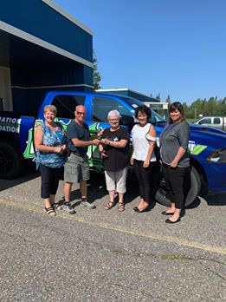
Winners of 2019 draw
$250.00 - Normand Labonté
$250.00 - Lance Costante
$500.00 - Bernard Lavoie
$1,500.00 - Manon Gagné
$2,500.00 - Larry Loubert
DODGE RAM 2019 – Jacques Rouleau

Slide 56
Fondation de l’hôpital de Smooth Rock Falls Hospital Foundation
Tirage 2020 Draw
We have filled the blanks?
Les gagnants !
Prize /prix 6 $250.00 Mona(Jacques) VanMarrem
Prize / prix 5 250,00 $ Thérèse Filion
Prize / prix 4 $500.00 Linda Cousineau
Prize / prix 3 1500,00 $ JF Séguin
Prize /prix 2 $2500.00 Angèle, Nat et Léo Marchand

Slide 57
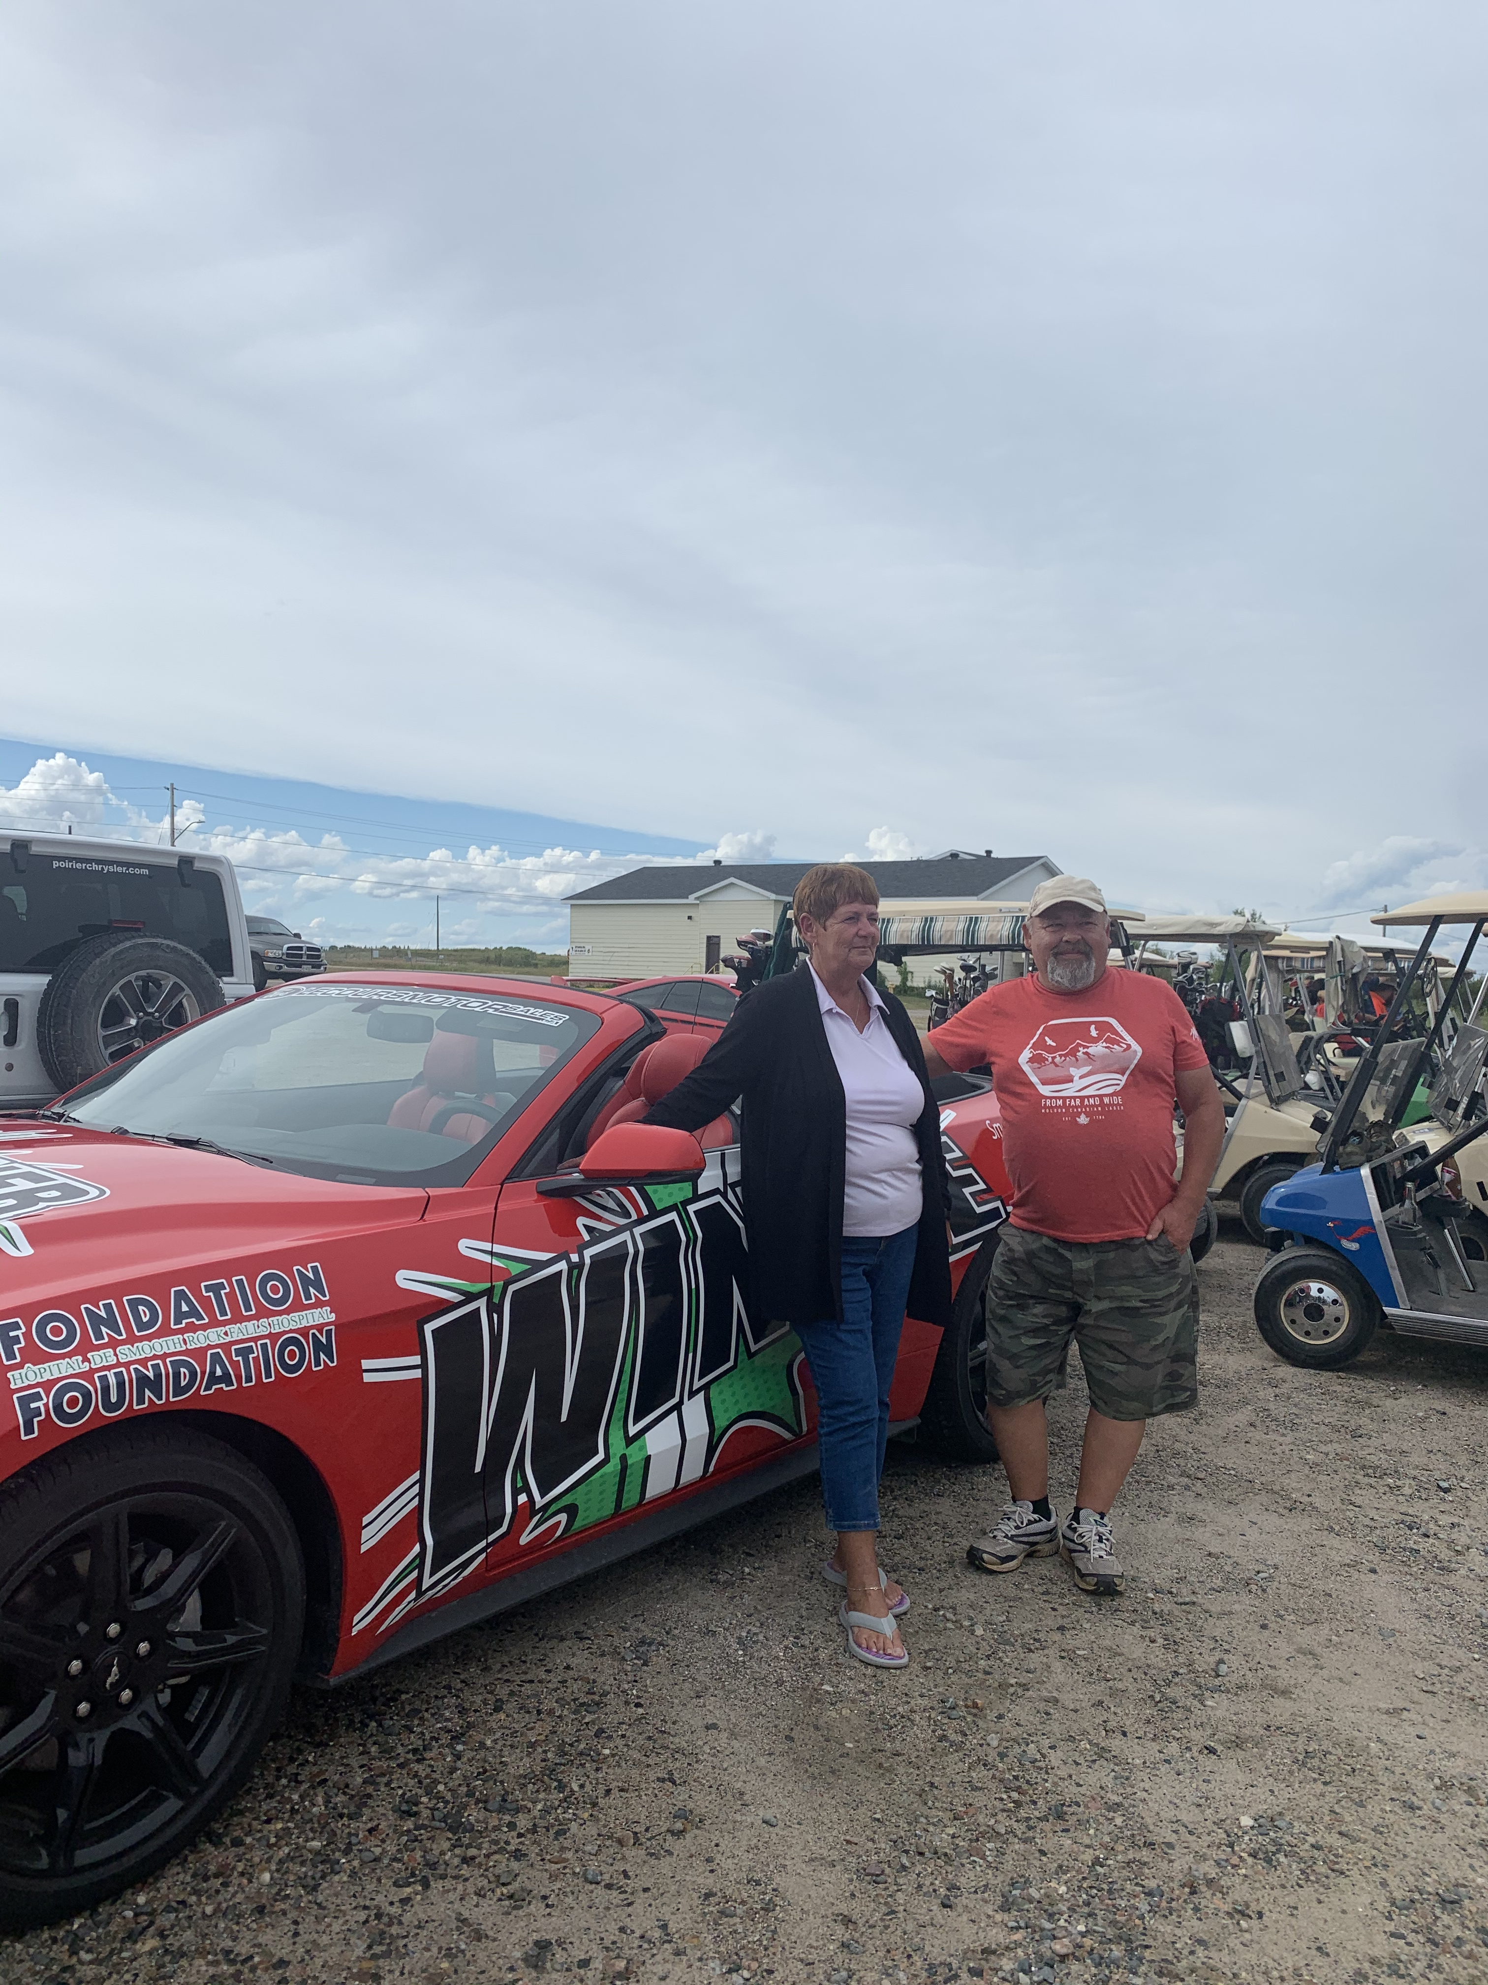
Grand Prize /le grand prix #1
Mary and Yvon Lepage

Slide 58
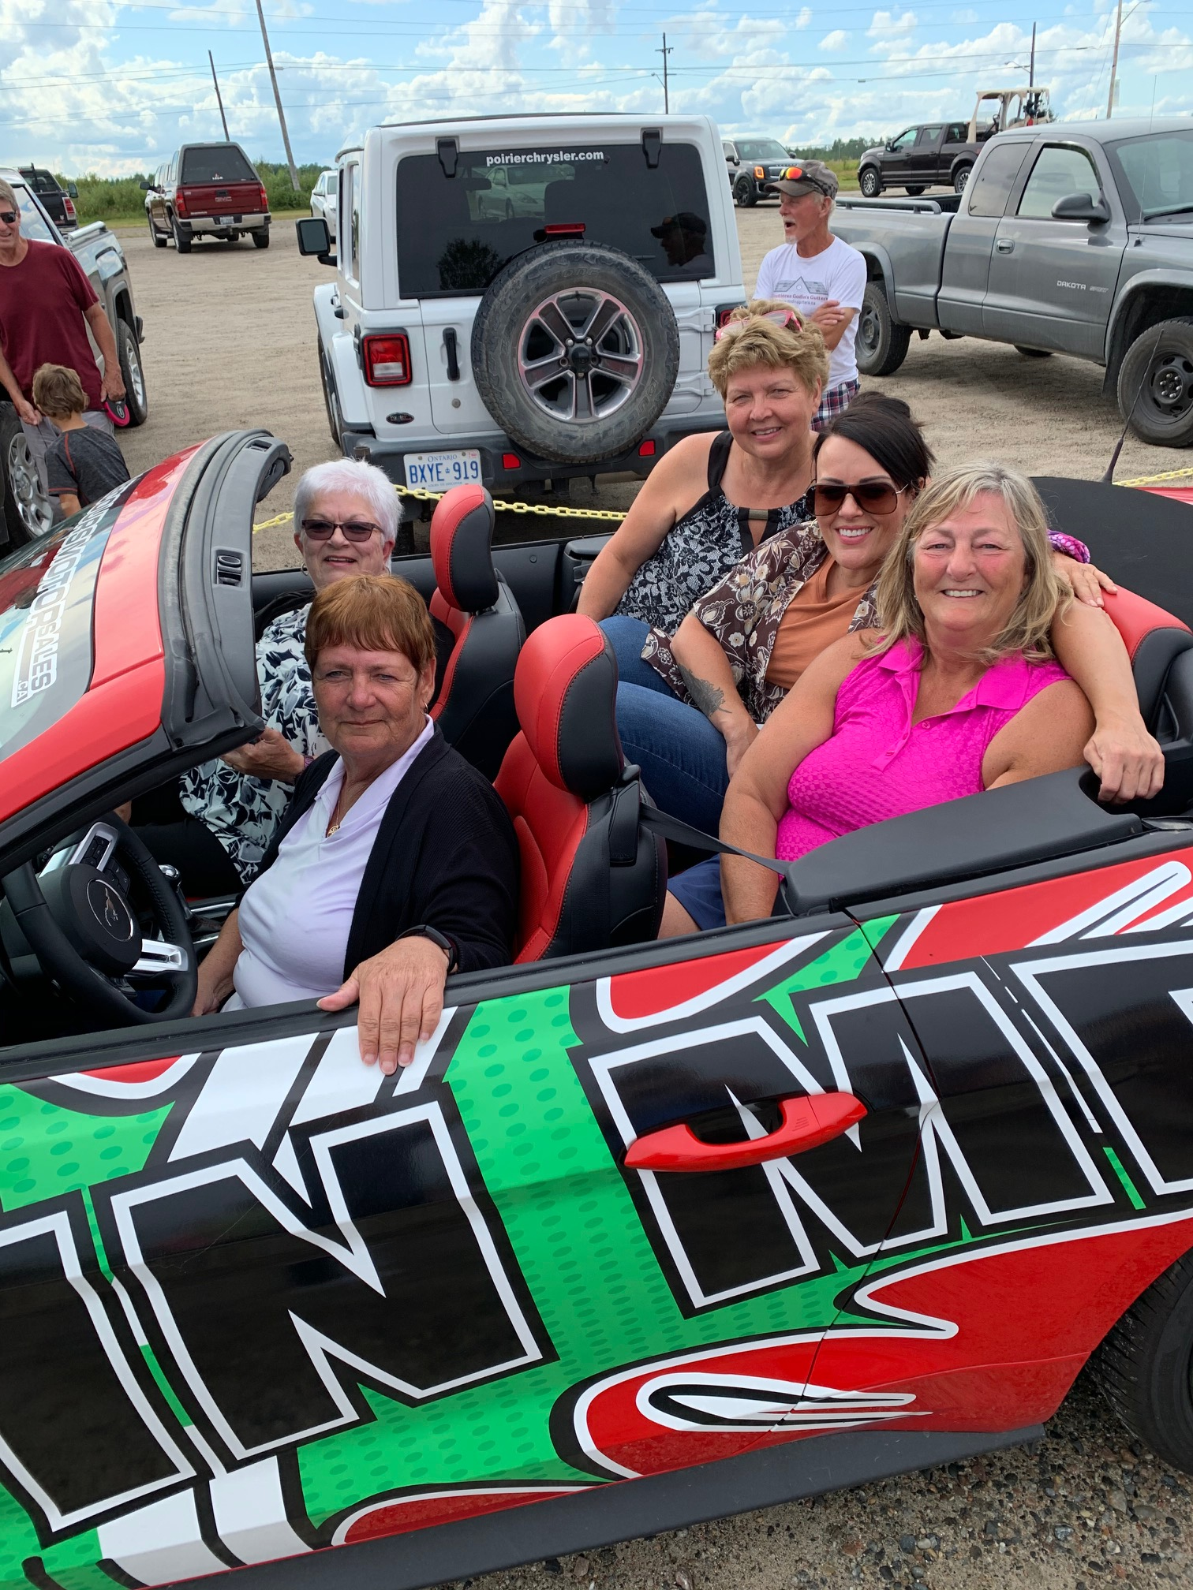
Members of the Foundation with the Mustang 2020 winner
Mary Lepage in driver’s seat !

Slide 59
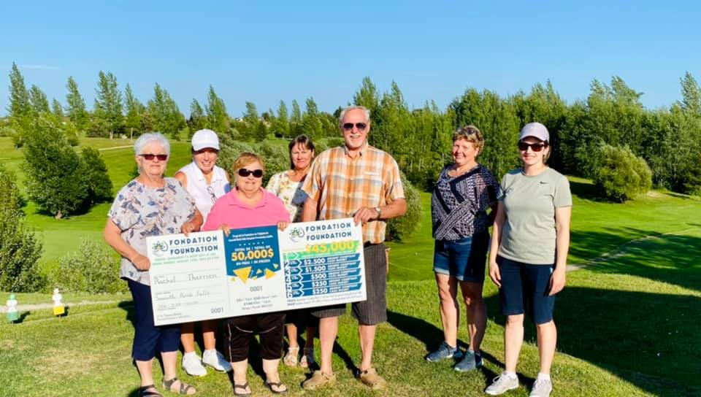
Members of the Foundation with the 2021 winner of $45,000
Rachel Therrien with her husband Denis.

Slide 60
Fondation de l’hôpital de Smooth Rock Falls Hospital Foundation
Tirage 2021 Draw
We have filled the blanks?
Les gagnants !
Prize /prix 6 $250.00 Clara Jacques
Prize / prix 5 250,00 $ Joanne Blake
Prize / prix 4 $500.00 André Filion
Prize / prix 3 1500,00 $ Chantal Tessier
Prize /prix 2 $2500.00 Monic Albert et Mona Klein

Slide 61
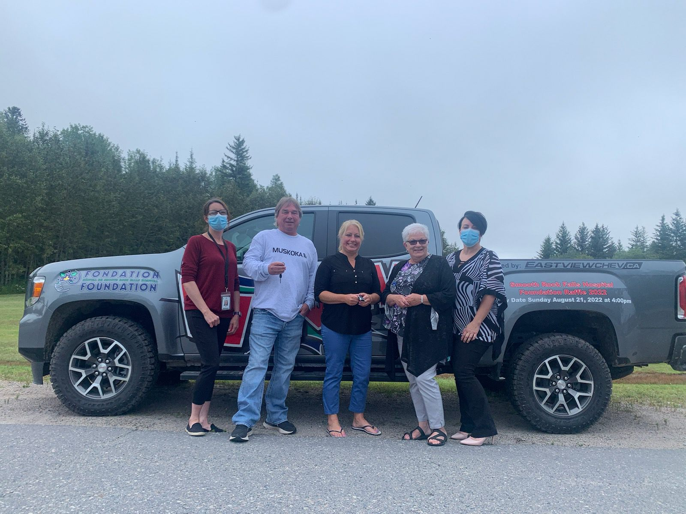
The winnier of the truck Neil Schell along with Tracy Gagnon who sold him the ticket, his partner Jennifer DeCaire, Marielle Cousineau president of the Foundation and Melonie Loubert CEO of the Smooth Rock Falls Hospital.
Neil Schell, 2022 annual draw winner

Slide 62
Fondation de l’hôpital de Smooth Rock Falls Hospital Foundation
Tirage 2022 Draw
We have filled the blanks?
Les gagnants !
Prize /prix 6 $250.00 Vondelle Oreskovich
Prize / prix 5 250,00 $ Jean-Guy Lamothe
Prize / prix 4 $500.00 Colleen Makillop
Prize / prix 3 1000,00 $ André et Éliane Bernier
Prize /prix 2 $2500.00 Al Dubord

Slide 63
We supported the 2021 Christmas Campaign to raise funds to update the X-ray department
Robert Connor Roger & Janis Plourde Thérèse Desbiens
Francine Gagnon Robert Béchard René Gravel
Jean-Marie et Alayne Couture Kyran Biglow
Anonymous Jean-Yves Marquis Andrew Smith
Eda Hildebrand Alain Couture Thérèse Bergeron
Hélène Poirier June & Gilles Bernard Georges Blais
Jean-Louis Lévesque Jules Gendron Line Thériault
Patricia & Michel Dubord Roger Therrien
Réjeanne Grenier Louise Blais Roger Gallant
Marcel & Thérèse Caouette Diane Bernier
Marie Bourgon Lucette Lamothe Francine Rioux
Léo Paul Gravel Nicole Boivin Robert Mainville Gilbert & Line Pelletier Rollande Dubé Edouard Gravel
Ernest & Marie Demers Denis Sergerie

Slide 64
We supported the 2021 Christmas Campaign to raise funds to update the X-ray department
Thomas & Dianna Rennie Carole Brunet Ron & Diane Browne
Gilles Daigle Lionel Perreault Viviane Gravel
Lorraine & Jacqueline Marcoux Kathy Taylor
Jeannette & Carmelle Brûlé Claude et Francine Lévesque
Ethel Léonard Benoit Lepage Line & Richard Mercier
Paulin & Roberte Hébert Marc & Myriam Gagnon
Marc & Chantal Albert Joanne Bennett Yolande Thomas
Albert Flooring & Remodeling Fern Gredger Julie Lavoie
Judith Lévis Marielle Cousineau Judith Lévis
Hélène Lamothe Jean-Marc Bérubé Dianne Riopel
Maurice & Jacqueline Guertin Eleanor Cousineau
Smooth Rock Falls Pharmacy John Mc Neish & Francine Lagace
Ubald & Emilienne Mercier Philippe et Agathe Fortin Yvon St-Pierre
Maurice Fraser Service Centre Brigitte Couture Gilles & Suzanne Brunet

Slide 65
We supported the 2021 Christmas Campaign to raise funds to update
the X-ray department
Gilles & Audrey Loiselle Ginette Chartrand Lisette Boucher
Waleston Labonté André Mainville Clara & Emile Jacques
Héléne (Gervais) Gillissie Chevaliers de Colomb Diane & Robert Richer
Josette & Guy Rockburn Pauline & Carol Labonté Cécile Gagnon
Linda Cousineau Gilbert Lacroix Germain Petit
Roland & Denise Daoust Louise Priebe-Gagnon Manon Malenfant
Lina Arseneault Darryl Demers Jacqueline Dubord
Lise & Lawrence Simpson Nicole & Agustin Landry Léona Mattuissi
Suzanne & Guy Boivin

Slide 66
We supported the 2022 Christmas campaign to raise funds to buy new beds for the LongTerm Care Unit
LéoPaul Gravel Nicole & Augustin Landry Alain Couture
Line Thériault Denise & Jean-Pierre Frénette Kyran Biglow
Waleston Labonté Normand & Diane Labonté Manon Malefant
Ronald Lamothe Susan & Claude Therrien Betsy & Robert Connor Janis & Roger Plourde Myriam & Marc Gagnon Micheline Hudson
Louise Blais Rose Anna & Gérald Petit Conrad Labonté
Lina & André Mercier Ethel Léonard Germain Petit
Faye & Paul Desbiens Marie & Ernest Demers Robert Mainville
Ann & Gilbert Lacroix Patricia & Michel Dubord Yvon St-Pierre
Irène Gravel Pauline & Carol Labonté Dave Marlow
Paul Guénette Jeannine Bédard Diane Bernier
Denis Sergerie Lynne & Gilbert Pelletier Mimi & Ubald Mercier
Jean-Marc Huet Jacqueline & Maurice Guertin Jacqueline Marcoux

Slide 67
We supported the 2022 Christmas campaign to raise funds to buy new beds for the LongTerm Care Unit
Filles d’Isabelle, Cercle Ste Thérèse de l’enfant de Jésus Rolande Dubé
Thérèse Caouette Suzanne & Gilles Brunet Jean-Yves Marquis
Ian Colaiezzi Denise St-Pierre Sheila & James Boucher
Yolande Thomas Jean-Louis Lévesque Bruno Goyette
Kathy Taylor Francine & Claude Lévesque Suzanne Ethier
Clément Racette Robert Béchard Denis Lasalle
Hélène Gillissie Denise Jolie Brigitte Couture
Marielle Cousineau Angela & Christine Williams Nicole Boivin
Diane Papineau Linda Cousineau & Roger Marinier
Edouard Gravel Thomas & Dianna Rennie Eleanor Cousineau
Maurice Fraser Service Centre Ginette Chartrand
Thérèse Bergeron Lise & Larry Simpson Arlette & Jules Lepage
Theresa Phillips Richard Graine & Lina Béchard Raymond Labonté
Albert Flooring & Remodeling Jacqueline Dubord
Hélène & Jean-Guy Poirier Jean-Yves & Nicole Leblanc
Dianne & Ron Browne

Slide 68
Get involved, become a volunteer !
The Smooth Rock Falls Hospital Foundation is looking for volunteers to fill positions on the Board of Directors!
To join the Council, please send a letter to the foundation indicating your interest. Everyone who sits on the board must be bilingual.
Volunteering for the foundation is doing something different for the betterment of your community.
To contact us: fondation@srfhosp.ca or 705-338-3323

Slide 69
The Foundation members thank everyone for their ongoing support. Our success is caused by your generosity!
This site will be updated on a regular basis

